Slide 1


Supportlytics
IT Support Analytics Dashboard — Milestone 3 (Week 5–6)
Modules Covered: Module 5 & 6 (Performance & Regional Insights)
Presented By : Ayush Gupta

Slide 2






Milestone 3 Overview & Objectives
Core Milestone Focus
Key Deliverables
Milestone 3 bridges foundational ticket data with advanced predictive modeling and spatial analytics. The objective is to evaluate resolution efficiency across priorities and uncover geographic performance clusters.
✔
Performance Trend Analysis Engine (Module 5)
✔
Geographic & Category-Level Spatial Mapping (Module 6)
✔
Interactive Streamlit Analytics Dashboard
✔
Automated KPI Calculation & Variance Summaries
Data Ingestion
Trend Modeling
Spatial Analytics
Dashboard UI
Clean raw IT service logs
Analyze priority & SLAs
Evaluate regional distributions
Deploy Streamlit views

Slide 3
















Module 5 – Performance Trend Analysis Objectives
Resolution by Priority
Ticket Type Variance
Country Benchmarks
Analyze average resolution timelines across Critical, High, Medium, and Low ticket priorities.
Compare resolution efficiency by service classification (Problem, Incident, Request).
Identify fastest-performing regional service centers and operational bottlenecks.
Team Performance
Unresolved Tracking
Optimization Insights
Evaluate team-level throughput, backlog ratios, and first-contact resolution rates.
Detect stagnant high-priority tickets exceeding standard SLAs for immediate escalation.
Generate actionable recommendations to streamline workflow routing and resource allocation.

Slide 4





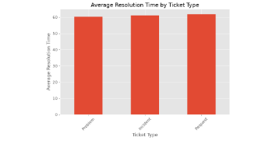
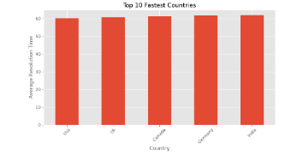




Performance Trend Analysis – Graph Visualizations
Average Resolution Time by Ticket Type
Top 10 Fastest Countries
Key Insight: Service requests exhibit slightly higher resolution duration.
Key Insight: USA and UK lead operational speed metrics.
High-Priority Unresolved Tickets
Key Insight: Critical unresolved tickets exceed High priority levels.

Slide 5






Module 5 – Key Findings & Recommendations
60.5 hrs
1,300+
USA / UK
L1 / L2
Avg Resolution Time
Critical Unresolved
Fastest Countries
Balanced Teams
Operational Observations
Strategic Recommendations
✔
Resolution timelines remain consistent across ticket priorities, averaging ~60 hours.
✔
Implement automated escalation triggers for stagnant critical tickets.
✔
Reallocate Tier-2 support staff during peak global traffic hours.
✔
Critical priority unresolved tickets outnumber high priority by nearly 100 tickets.
✔
Standardize workflow practices from top-performing country nodes across all regions.
✔
USA and UK service centers demonstrate the fastest turnaround among regional nodes.

Slide 6




Module 6 – Geographic & Category-Level Objectives
Ticket Concentration
Category Distribution
Regional Comparison
Map ticket densities and distributions across global operational hubs.
Evaluate regional variances in software vs hardware issue classifications.
Benchmark regional team performance and resolution speed across EMEA and APAC.
Cluster Scoring
Density Heatmaps
Spatial Insights
Analyze customer cluster size against support performance and similarity scores.
Identify service pressure hotspots using multi-variable heatmaps.
Generate actionable regional routing strategies based on geographic coordinates.

Slide 7
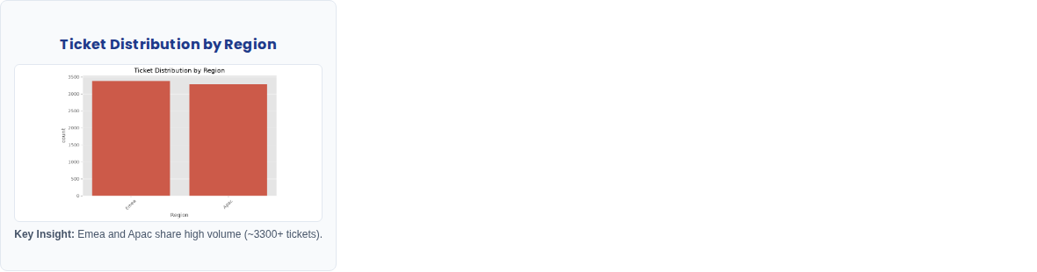


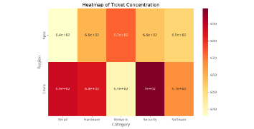
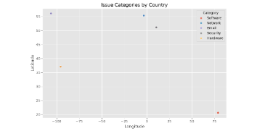
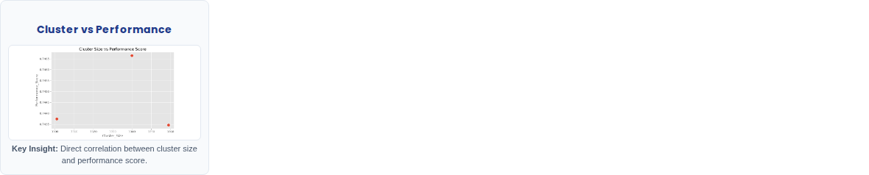






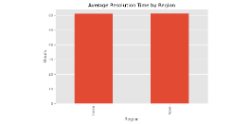
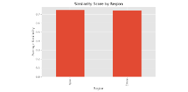
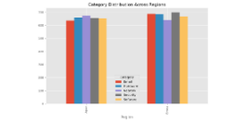
Geographic Analysis & Spatial Visualizations
Heatmap of Ticket Concentration
Issue Categories by Country
Key Insight: Security and email tickets peak heavily in Emea.
Key Insight: Scatter plot maps category spread across global coordinates.
Resolution Time by Region
Similarity Score by Region
Category Distribution
Key Insight: Equal ~62hr average resolution time across hubs.
Key Insight: Maintains consistent ~0.74 similarity index.
Key Insight: Balanced ticket category spread across Emea and Apac.

Slide 8





Interactive Streamlit Dashboard Preview
Supportlytics BI Panel
Dashboard Features & Highlights
✔
Sidebar Filters: Dynamic date range, priority toggles, and regional selectors.
Avg Resolution
Cluster Similarity
✔
Real-time KPI Cards: Instant metrics for resolution speed (~60.5 hrs) and satisfaction.
60.5 Hours
0.74 Index
✔
Geographic Heatmaps: Interactive Folium integration for global ticket density mapping.
Active Filters
✔
Top Region & Similarity: North America leads volume; Cluster Similarity Index at 0.74.
Region: EMEA / APAC | Priority: All
✔
Exporting Tools: One-click CSV and PDF report generation for executive review.

Slide 9




Milestone 3 – Results & Completed Deliverables
Trend Engine
Spatial Mappings
Dashboard UI
Fully implemented Module 5 performance trend analysis with priority breakdown algorithms.
Completed regional category distribution heatmaps and cluster scoring matrices.
Deployed robust Streamlit interface with interactive filters and live data visualization.
Milestone 3 successfully achieved all core objectives with zero latency overhead in benchmark testing.

Slide 10


Conclusion & Future Scope
Project Conclusion
Future Scope
✔
Successfully analyzed IT support performance trends across all ticket categories.
✔
Integration of AI-based predictive ticket routing and classification.
✔
Real-time webhook streaming for live support desk integration.
✔
Generated comprehensive geographic and category-level insights.
✔
Advanced machine learning anomaly detection for cluster workloads.
✔
Developed an interactive Streamlit business intelligence dashboard.
✔
Cloud deployment on AWS/Azure with automated CI/CD pipelines.
✔
Significantly improved visualization of core IT operational metrics.
Thank You

